Slide 1

Understanding Behaviour Through Affect Script and Compass of Shame Dr Scott I-Patrick Senior Educational Psychologist

Slide 2

Session Overview & Objective
Session Overview
The session will lay the groundwork for understanding these pivotal concepts of Affect Script and Compass of Shame, then move beyond theory to explore their practical applications in classrooms.
Objective
The aim is to not only build a foundational understanding of these theories but also to equip ourselves with effective strategies for addressing the emotional and behavioural needs of our students.
Notes:
Welcome Message
"Hello everyone, I'm . Today, we embark on an insightful journey into Affect Script Theory and Nathanson's Compass of Shame, and their profound impact on our students' behaviour."

Slide 3

Introduction to Key Concepts
An exploration of the core elements of Affect Script Theory and Nathanson's Compass of Shame.
Linking Theory to Practice: Focus will be on practical application
Notes:
These insights are crucial for any educator looking to deeply understand student behaviour.
As we delve into these psychological frameworks, we'll connect them to the behaviours we observe in our students. Our focus will be on practical application, ensuring these concepts are not just theoretical but are translated into tangible strategies for classroom use.

Slide 4

Practical Outcomes
Our journey today will take us from theoretical understanding to real-life applications. By the end of this session, The aim is to provide practical tools and strategies that enhance our capacity to support our students' emotional and educational needs empathetically and effectively.

Slide 5

From Affect to Affect Scripts
What is Affect?
The Basics of Emotional Responses
Notes:
Introduction to Affect: Understanding Emotional Responses
"Let's start by defining what we mean by 'affect'. Affect refers to our immediate, primary emotional responses to stimuli. These responses can be positive, like happiness or excitement; neutral, such as curiosity; or negative, including emotions like sadness or anger."
"It's crucial to understand these basic emotional responses, as they are the building blocks of more complex emotional patterns that we will explore later."

Slide 6

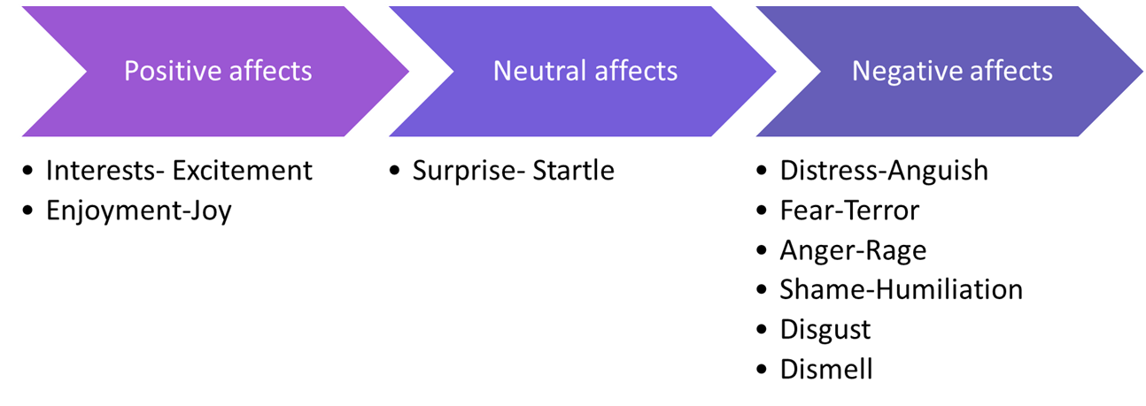
cOmpass of Shame scripts
Notes:
I

Slide 7
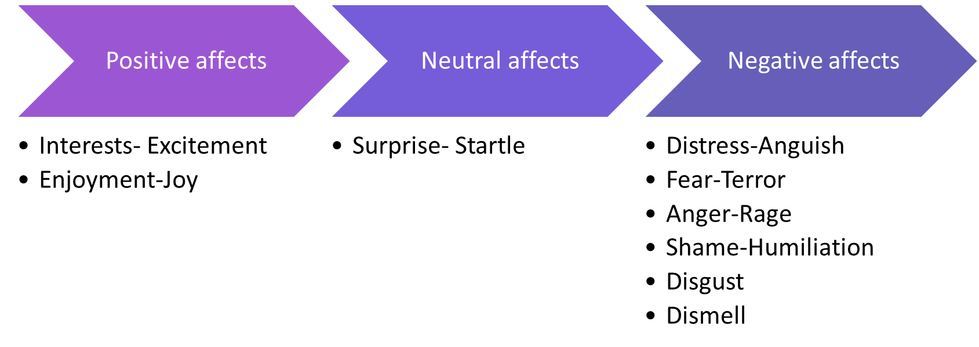
Notes:
Examples of what might trigger these affects include:
Pupil’s senses picking up something to big, too loud, or too fast, and/or feeling threatened (fear-terror).
Response triggered when too much has been happening for too long, or when overwhelmed (distress-anguish).
When that too much finally stops happening or a reward is received (enjoyment-joy).
When senses encounter a novel stimulus that is just right or discovering something new (interest-excitement).
Experiencing an unexpected event (surprise-startle).
Being treated unfairly (anger-rage).
Encountering something unpleasant (disgust).
Feeling exposed (shame-humiliation).
Select one or two examples- don’t go through them all
A pupil's biography can intensify their reactions to situations. This is particularly true when pupils are confronted with challenges that have persisted for a long time.
Pupils may use presenting behaviours as a way to maximise positive affects and avoid negative affects triggered by persistent challenges. For example, a pupil who has experienced neglect may seek attention through disruptive behaviour, as a way of compensating for the lack of attention they received at home.
By understanding the role of biography, we can begin to recognise the underlying needs of pupils and respond to them in a more targeted way.
Most of the experiences of interest and joy that get impeded have to do with interpersonal engagement with others. So, think of shame as an interpersonal/interactional affect.
Once positive affect is impeded, the affect shame focuses attention on the impediment that triggered the negative affect.
Now, the thing is what we see in the moment of shame is something in us that isn’t perfect – scripted emotions/biography.
Pupil’s draw on scripts built up over time to help minimise the destructive impact of negative affects…

Slide 8

Examples of Affects in Action
Consider a student, Alex, who feels a rush of joy when praised for good work. Alternatively, imagine Mia feeling a wave of disappointment when she struggles with a math problem. These are instances of affects in action, immediate emotional responses to specific situations.

Slide 9
The Journey from Affect to Affect Scripts
How do we move from these individual affects to affect scripts?
Affect scripts are formed when these emotional responses become patterned and internalised over time.
They evolve from our repeated experiences with similar stimuli or situations.
Notes:
Now,…

Slide 10
Role of Repeated Affects in Script Formation
If Alex consistently receives positive reinforcement, he may develop a script associating effort with positive outcomes. This script becomes a lens through which Alex views learning experiences, influencing his future behaviours and emotional responses.
Notes:
For instance, …

Slide 11

Case study 1:Positive Script Formation
Background: Consider Sarah, a student who consistently receives praise and encouragement for her efforts, regardless of the outcome. Her teachers focus on the process of learning rather than just the results.
Script Development: Over time, Sarah develops a positive script. She associates effort with positive emotions, such as pride and satisfaction, fostering a growth mindset. She is not afraid to make mistakes, viewing them as part of the learning process.

Slide 12

Behavioural Outcome
In class, Sarah actively participates, takes on new challenges, and demonstrates resilience in the face of difficulties. Her positive script guides her to approach learning with enthusiasm and a belief in her own capabilities.

Slide 13
Case Study 2 - Negative Script Formation
Background: Now, let's look at Tom, who often receives criticism for his mistakes. He rarely hears positive feedback about his efforts, leading him to associate schoolwork with negative emotions.
Script Development: Tom develops a negative script. He starts believing that effort leads to disappointment and criticism. This script ingrains in him a sense of fear and avoidance towards learning and trying new tasks.

Slide 14
Behavioural Outcome
In the classroom, Tom is reluctant to participate, often appears disengaged, and may even exhibit disruptive behaviour as a defense mechanism. His negative script leads to a lack of self-confidence and a fear of failure.

Slide 15
Reflective Activity
I invite you to reflect on your students. Think about their behaviours and try to identify potential scripts they might be following. Consider their reactions to success, failure, and feedback. What emotional patterns can you discern?
Notes:
Discussion Prompt: "After reflecting, let's discuss these observations in small groups. Share examples and consider how different scripts might be influencing these behaviours. This exercise aims to enhance our awareness of the emotional narratives playing out in our classrooms."

Slide 16

Strategies: Identifying and Influencing Scripts
Consistent Positive Reinforcement: Regularly acknowledge and celebrate students' efforts, not just their achievements. This approach can help in developing positive scripts, reinforcing the idea that effort is valuable and appreciated.
Creating a Safe Emotional Space: Foster an environment where students feel safe to express their emotions. Encourage them to share their feelings and experiences, helping them to understand and navigate their emotional scripts.
Incorporating Mindfulness Practices: Introduce mindfulness activities, such as guided breathing or reflection exercises. These can help students become more aware of their emotional responses and learn to manage them effectively, thereby influencing the formation of more adaptive scripts.

Slide 17
Balancing Affects: The Role of the Central Executive
The Central Executive's Role:
Our central executive acts as an internal moderator, guiding us to maximize positive emotions and minimize negative ones. It’s vital in our pursuit of a balanced emotional state.
Our Innate Guide for Emotional Balance
Maximizing Positive Affect: Cultivating Joyful Experiences
Minimizing Negative Affect: Navigating Challenges
Minimizing Inhibition of Affect: Encouraging Emotional Expression
Achieving a Balanced SEMH: Integrating 1 to 3 in Education

Slide 18
Balancing Affects: The Role of the Central Executive
Examples
In school settings, CYP often rely on adults to understand and support them. For example, a child in care might experience instability and emotional challenges, needing an environment that maximizes positive affect through supportive interactions.
Alternatively, a child experiencing bereavement or domestic violence needs a space where their negative affect is not suppressed but acknowledged and addressed, fulfilling the central executive’s role of minimizing the inhibition of affect.

Slide 19
Educational Implications
When educators fail to provide such support, it leads to an imbalance, often resulting in masking or adverse outcomes.
This highlights the importance of our role in creating an environment that adheres to these principles of emotional regulation.

Slide 20

Strategies for Educators
We can foster a balanced SEMH by:
Encouraging the expression of all emotions
Providing support for negative experiences and celebrating positive moments.
This approach not only adheres to our innate emotional needs but also creates a nurturing educational environment.

Slide 21

Harnessing Joy and Interest in Learning
Igniting Learning through Intrinsic Motivation
The Essence of Intrinsic Motivation: Joy and Interest as catalysts
The Drawbacks of Extrinsic Motivation: Understanding Limits
Customising Learning: Tuning into Individual Interests
Notes:
Intrinsic Motivation at the Core
"Intrinsic motivation lies at the heart of effective learning. It's about tapping into what naturally excites and interests children. When learning aligns with a child’s natural curiosities and joys, it becomes more meaningful and engaging."
Contrasting with Extrinsic Motivation
"While extrinsic motivators like rewards or grades can be effective in the short term, they often fail to sustain long-term engagement. Forced motivation, especially in areas that don’t resonate with a child’s interests, can lead to disengagement or aversion to learning."
Personalizing Learning
"Imagine the transformation in our classrooms if we personalize teaching to each child’s interests. For instance, a child fascinated by storytelling could learn history through narratives, or a tech-savvy student could explore math through coding projects. This approach not only fosters a love for learning but also supports emotional and cognitive development."

Slide 22
Motivational Cycles in Education
Student fails task
Self-fulfilling prophesy
Attributes poor score on ability rather than effort
Teacher lowers expectations
Low self efficacy-off task behaviour
Teacher support not rewarded with improved results
Notes:
School System Vs The Individual
System set up in contradiction to our understanding of child development
(Children develop at different rates, whereas school look at standardised developmental expectations through assessments
Student fails task, or does worse in comparison to peers
Attributes results to ability rather than effort
Develops low self-efficacy
Teacher, who is also subject to performance evaluation based on student results- tries to support but due lack of skill, or understanding of self –efficacy, their support is not rewarded by an improvement in student results.
Teacher turns to those students who reward the teacher input with good results, focus on these students instead.
Teacher develops lower expectations of that student
Student responds to teacher expectation further re-enforcing their low expectations.

Slide 23

Practical Application
To implement this, we need to become adept at recognising each child's unique interests and motivators.
This requires keen observation, open communication, and a flexible teaching approach.
It is about creating a learning environment that kindles curiosity and passion in each student, making their educational journey as unique as they are.

Slide 24
Navigating the Complexities of Shame
Decoding Nathanson's Compass of Shame
Understanding the Four Responses to Shame
The Role of Shame in Learning and Relationships
Recognising and Addressing Shame Responses in Students
Notes:
Introducing Nathanson's Compass of Shame
"Having explored affect scripts, let's now delve into Nathanson's Compass of Shame. This model outlines four common responses to shame: Withdrawal, Avoidance, Attack Self, and Attack Others. These are ways individuals, including students, might cope with feelings of shame."

Slide 25
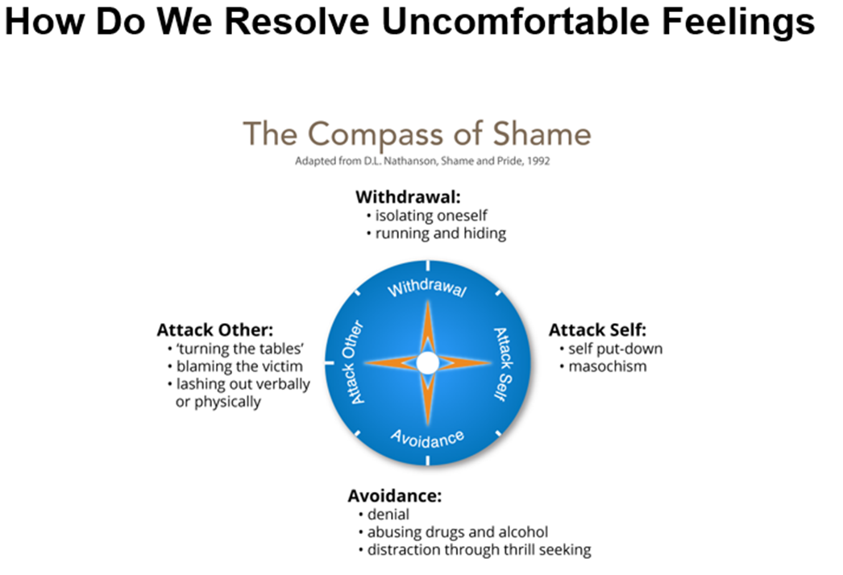
cOmpass of Shame scripts
Notes:
I

Slide 26
Real-Life Examples
Consider Farouk, a student who, overwhelmed by anger and shame, resorted to aggression, illustrating the 'Attack Others' quadrant​​.
Contrast this with Caslin, who felt misunderstood and labelled, possibly leading to 'Withdrawal' or 'Attack Self' responses​​.
Notes:
Recognizing these responses is key for us as educators to intervene empathetically and effectively."

Slide 27

Impact of Shame in Educational Context
Shame can significantly impact learning and relationships in school
Strategies for Educators
It's crucial to create a learning environment that minimizes shame and promotes emotional safety. This involves:
understanding each student's emotional landscape
offering support without judgment
fostering a culture where mistakes are seen as learning opportunities rather than sources of shame.
Notes:
Students like Hilton, who experienced learned helplessness, may show avoidance or withdrawal when their needs for understanding and inclusion aren't met . By identifying these shame responses, we can tailor our approach to support each student's unique emotional needs."

Slide 28

Fostering Trust and Safety: Key to Effective Support
Cultivating Trust and Safety in the Learning Environment
Essential Role of Trust in Emotional Regulation and Learning
Creating a Safe Space for Handling Affects and Shame
Enhancing Learning through a Trust-Based Approach
Notes:
Connecting Trust with Previous Themes:
"In light of our exploration of affect scripts and Nathanson's Compass of Shame, it's clear that trust and safety form the bedrock of effective educational support. These elements are crucial for managing emotional responses and shame in students."
Building Trust with Students:
"Fostering trust involves more than just consistent and empathetic interactions. It's about recognizing and validating students' emotional scripts and responses to shame. Being a reliable, understanding figure helps students feel secure, enabling them to navigate their emotions more effectively."
Creating a Safe Learning Environment:
"A learning space where students feel safe and valued is fundamental. It allows them to express emotions linked to affect scripts and shame without fear. This environment encourages open communication, vital for addressing complex emotions and promoting genuine learning engagement."
Impact of Trust on Educational Outcomes:
"The presence of trust and safety significantly enhances the effectiveness of our support. When students feel understood and supported, especially in the context of their emotional narratives, they are more likely to embrace learning challenges and grow. Our role in cultivating these conditions is paramount to our students' success and well-being."

Slide 29
Embracing Emotional Intelligence in Education
Integrating Emotional Understanding for Holistic Education
Key Insights from Today's Session
The Role of Emotional Intelligence in Student Developme
Our Commitment as Educators
Notes:
Session Recap:
"Today, we've journeyed through understanding affect scripts, exploring Nathanson's Compass of Shame, and the vital role of trust and safety in the learning environment. We've also discussed practical strategies for applying these concepts in our classrooms."
The Importance of Emotional Intelligence:
"The core of our discussion today emphasizes the importance of emotional intelligence in education. Recognizing and responding to our students' emotional needs is as crucial as their academic learning. This approach not only aids in their cognitive development but also fosters emotional resilience and social competence."
Our Role and Commitment:
"As educators, our commitment extends beyond imparting knowledge. It involves nurturing our students' emotional well-being, understanding their unique emotional landscapes, and creating a supportive and inclusive environment. This holistic approach is key to empowering our students to thrive academically, emotionally, and socially."

Slide 30
Closing Thought
Let's carry forward the insights from today, integrating them into our teaching practices. Our goal is to cultivate a learning space where every student feels understood, valued, and supported, paving the way for their all-around success.

Slide 31
REFERENCES
George, G. (2014). Affect and Emotion in a Restorative School. In V. Kelly & M. Thorsborne (Eds.), The Psychology of Emotions in Restorative Practice (First, pp. 200–231). Jessica Kingsley.
Dweck, CS, 2012, Mindset, Constable & Robinson, London, 2012
Kelly, V. C. (2014). Caring, Restorative Practice and the Biology of Emotion. In V. Kelly & M. Thorsborne (Eds.), The Psychology of Emotions in Restorative Practice (First, pp. 200–231). Jessica Kingsley.
Nathanson, D.l. (1992) Shame and Pide: Affect, Sex, and the Birth of the self. New York, NY: W.W. Norton.
Tomkins. S. (2008) Affect Imagery Consciousness: the Complete Edition. New york, NY : Springer.

Slide 32
Handout: Practical Strategies for Emotional Support in Classrooms
Recognising and Addressing Affect Scripts
Observe emotional responses and encourage students to articulate their feelings
Use consistent positive reinforcement to influence and reshape negative scripts
Managing Shame Responses
Foster a non-judgmental and supportive environment for sharing emotions
Teach and practice coping skills like mindfulness and perspective-taking
Building Trust and Safety
Implement clear and consistent classroom rules
Actively listen and show genuine interest in students' lives and experiences
Celebrate diversity and encourage inclusivity

Slide 33

Handout: Practical Strategies for Emotional Support in Classrooms
Example for Affect Scripts
"Student A frequently exhibits frustration in math class. By discussing these feelings openly, the teacher realizes that Student A has developed a negative script associating math with failure. The teacher begins to acknowledge Student A's effort and small successes, gradually helping to shift this script."
Example for Shame Responses
"Student B often reacts defensively to feedback. Recognizing this as a potential 'Attack Others' shame response, the teacher creates opportunities for Student B to express feelings in a safe space and teaches strategies for constructive feedback acceptance."
Regular Check-ins: Schedule time for individual or group discussions about emotions and experiences

Slide 34

Handout: Practical Strategies for Emotional Support in Classrooms
Responsive Teaching: Adapt teaching methods to accommodate diverse emotional needs
Positive Reinforcement: Focus on effort and improvement, rather than just outcomes
Mindfulness Practices: Incorporate simple mindfulness exercises at the beginning or end of classes

